Slide 1


Microprocessor and its applications 2024-25
Dr. Chidananda Murthy M V
Associate Professor
Dept. of ECE,
Sri Siddhartha Institute of Technology
Sri Siddhartha Academy of Academy of Higher Education
Tumkur
chidanandamurthymv@ssit.edu.in

Slide 2
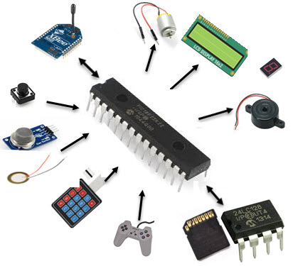
8051 I/O Ports, Timer/counter programming
Unit - 3

Slide 3
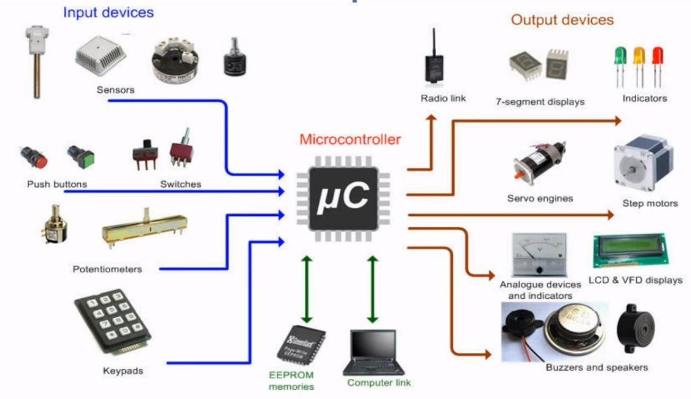
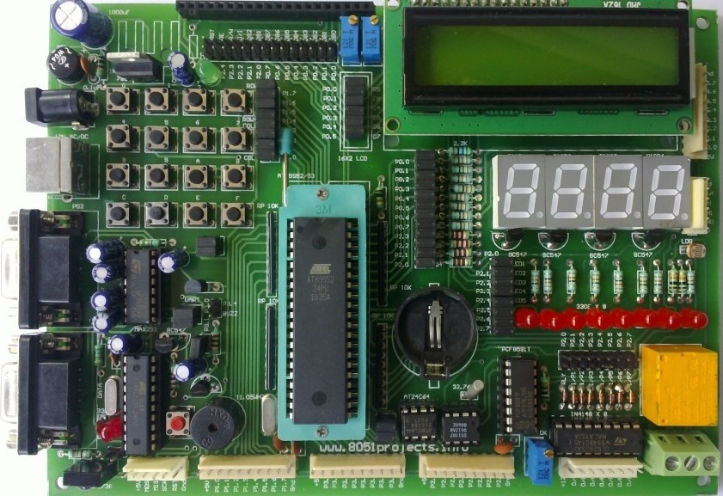
Peripherals

Slide 4
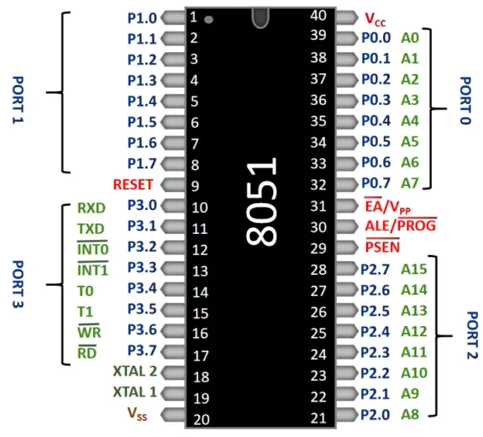
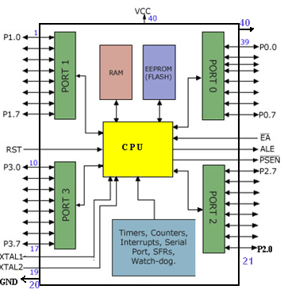
Ports of 8051

Slide 5
Pins 32 to 39: Pins 32 to 39 are known as Port 0 (P0.0 to P0.7), and they are multiplexed with low-order data/address bus signals
Pins 1 to 8: It is also known as PORT 1. The 8-bit bidirectional input and output ports
Pins- 21-28: The PORT 2 Pins on the 8051 Microcontroller are Pins 21 through 28. The PORT 2 pins function as either inputs or outputs because it is a bidirectional port. Additionally, PORT 2 pins work as the higher-order address byte when external memory is interfaced.
Pins 10 to 17: It is also known as PORT 3

Slide 6
Programming of ports
All the ports upon RESET are configured as input, ready to be used as input ports
When the first 0 is written to a port, it becomes an output To reconfigure it as an input, a 1 must be sent to the port
To use any of these ports as an input port, it must be programmed

Slide 7
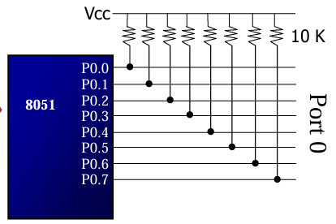
Port 0
It can be used for input or output,
each pin must be connected externally to a 10K ohm pull-up resistor
This is due to the fact that P0 is an open drain, unlike P1, P2, and P3

Slide 8
The following code will continuously send out to port 0 the alternating value 55H and AAH
BACK: MOV A,#55H
MOV P0,A
ACALL DELAY
MOV A,#0AAH
MOV P0,A
ACALL DELAY
SJMP BACK

Slide 9
In order to make port 0 an input, the port must be programmed by writing 1 to all the bits
Port 0 is configured first as an input port by writing 1s to it, and then data is received from that port and sent to P1
MOV A,#0FFH ;A=FF hex
MOV P0,A ;make P0 an i/p port by writing it all 1s
BACK: MOV A,P0 ;get data from P0
MOV P1,A ;send it to port 1
SJMP BACK ;keep doing it

Slide 10
Port 1
Port 1 can be used as input or output
In contrast to port 0, this port does not need any pull-up resistors since it already has pull-up resistors internally
Upon reset, port 1 is configured as an input port
The following code will continuously send out to port 0 the alternating value 55H and AAH
MOV A,#55H
BACK: MOV P1,A
ACALL DELAY
CPL A S
JMP BACK

Slide 11
Write programme
Port 1 is configured first as an input port by writing 1s to it, then data is received from that port and saved in R7

Slide 12
Write programme
Write a program to toggle all the bits of P0, P1, and P2 every 1/4 of a second

Slide 13
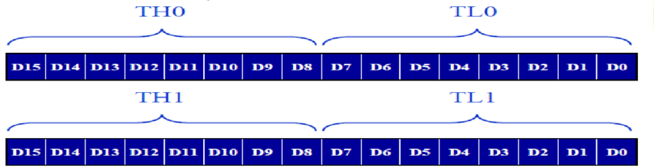
TIMERS AND COUNTERS
Timers/Counters are used generally for
Time reference
Creating delay
Wave form properties measurement
Periodic interrupt generation
Waveform generation
8051 has two timers,
Timer 0
Timer 1.

Slide 14
Timer in 8051 is used as timer, counter and baud rate generator. Timer always counts up
The time taken to count one digit up is based on master clock frequency.
If Master CLK=12 MHz,
Timer Clock frequency = Master CLK/12 = 1 MHz
Timer Clock Period = 1micro second
This indicates that one increment in count will take 1 micro second.

Slide 15
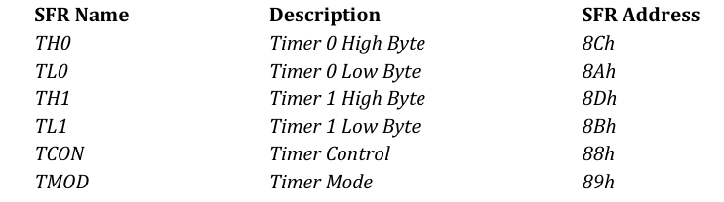
The two timers in 8051 share two SFRs
TMOD
TCON

Slide 16
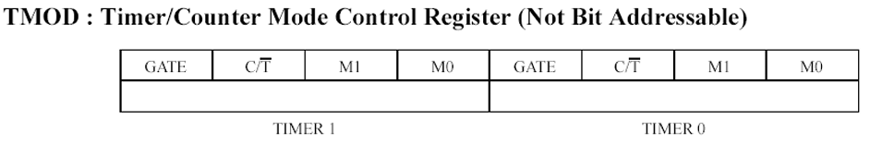
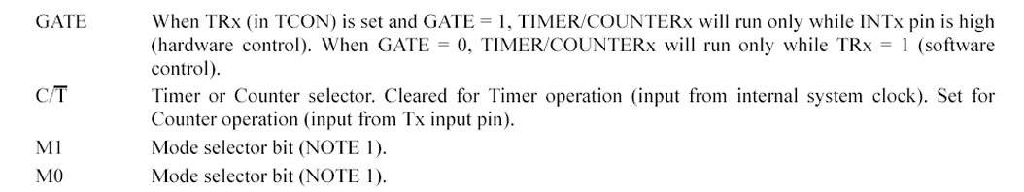
TMOD Register

Slide 17
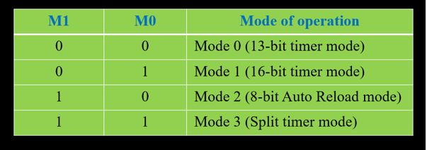
Timer/ counter mode selection

Slide 18
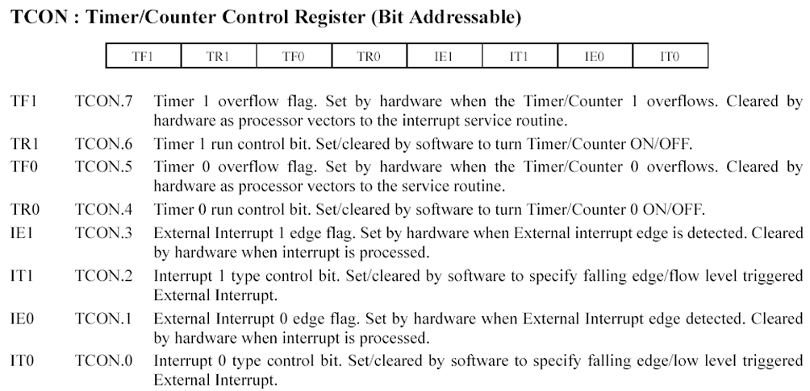
Tcon register

Slide 20
Study references
Muhammad Ali Mazidi and Janice Gillespie Mazidi and Rollin D, “The 8051 Microcontroller and Embedded Systems – using assembly and C”, 2014 , McKinl ay PHI, Pearson Publication
Notes.pdf
Difference Between Microprocessor and Microcontroller
Introduction to Microcontroller - Microcontrollers and Its Applications
RISC vs. CISC: Understanding Reduced Instruction Set Computer and Complex Instruction Set Computer
Von Neumann Vs Harvard Architecture: Parameters, Differences, and Key Features

Slide 21
Thank you
Dr. Chidananda Murthy M V
Associate Professor
Dept. of ECE, SSIT
SSAHE, Tumkur
chidanandamurthymv@ssit.edu.in

